Slide 1
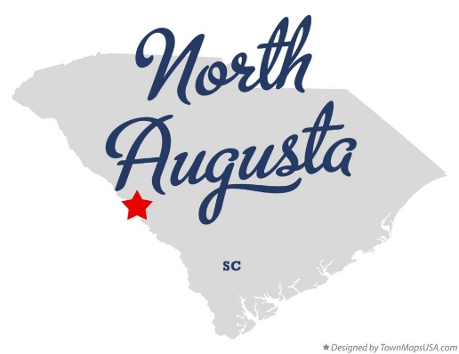
North Augusta Council Study Session – 16 November 2020

Slide 2
Budgeted Employee Raises
FACTS:
Previous Council guidance to analyze and present a 2% merit-based employee raise back-dated to 1 July 2020.
Ratings Agency recently updated City Bond Rating
Overall City revenues are down
North Augusta carried $331,000 into the Capital Project Fund at the end of the 2019 budget year
City is on a glide path with the General Fund revenue to reward employee performance with either the previously directed 2% merit increase, or with a bonus structure
244 total eligible employees (staff only - Mayor & Council excluded)
Staff options provided include a 2% merit increase; the difference is timing
Assumptions:
City Council wishes to reward employee performance
City needs to contribute at least $331,000 into the Capital Project Fund at the end of the 2020 budget year
City Council wishes to pass a resolution on 7 December

Slide 3
2% Merit Increase (1 July 2020)
Pros:
Based on previous Council guidance
Contributes to employee pension system
Employees were aware of this option
Cons:
Only benefits 196 employees (80% of workforce)
Based on 2019 performance reviews
High cost to the city
Total costs:
2% at mid year (1%) 170k
General Fund 120k
Sanitation 20k
Stormwater 5k
Utilities 25k

Slide 4
Alternative: 1% Annual Salary Bonus
Pros:
Provides a benefit to 240 employees
Provides 2% merit increase in Jan 2021 based
2020 performance evaluations
Provides a larger buffer in the General Fund
Lower Cost to the City
Cons:
Not the directed course of action
Doesn’t pay into employee retirement
Total costs:
1% Lump Sum Bonus 119k
General Fund 83k
Sanitation 13k
Stormwater 6k
Utilities 18k

Slide 5
Side by Side Comparison
 | 2% Merit – 1 July 2020 | 1% Bonus
Total employee benefit | 196 | 240
Total City Cost | $170,000 | $119,000
General Fund | $120,000 | $83,000
Sanitation | $20,000 | $13,000
Stormwater | $5,000 | $6,000
Utilities | $25,000 | $18,000
Date of 2% merit increase | 1 July 2020 | 1 January 2021

