Slide 1
MERIWETHER MONUMENT COMMITTEE REPORT TO COUNCIL
Submitted by :
the Calhoun Park Committee
Members: Charles Allen, Pat Carpenter, Tony Carr, John Felak, Trina Mackie,
David McGhee, Milledge Murray, Mandy Nelson, Mark Newell & Bob Pettit

Slide 2
Resolution 2019-10:
PROVIDED FINDINGS ABOUT THE HAMBURG INCIDENT OF 1876, AND
APPOINTED THIS COMMITTEE TO EVALUATE OPTIONS FOR AN ADDITIONAL DISPLAY IN CALHOUN PARK.

Slide 3
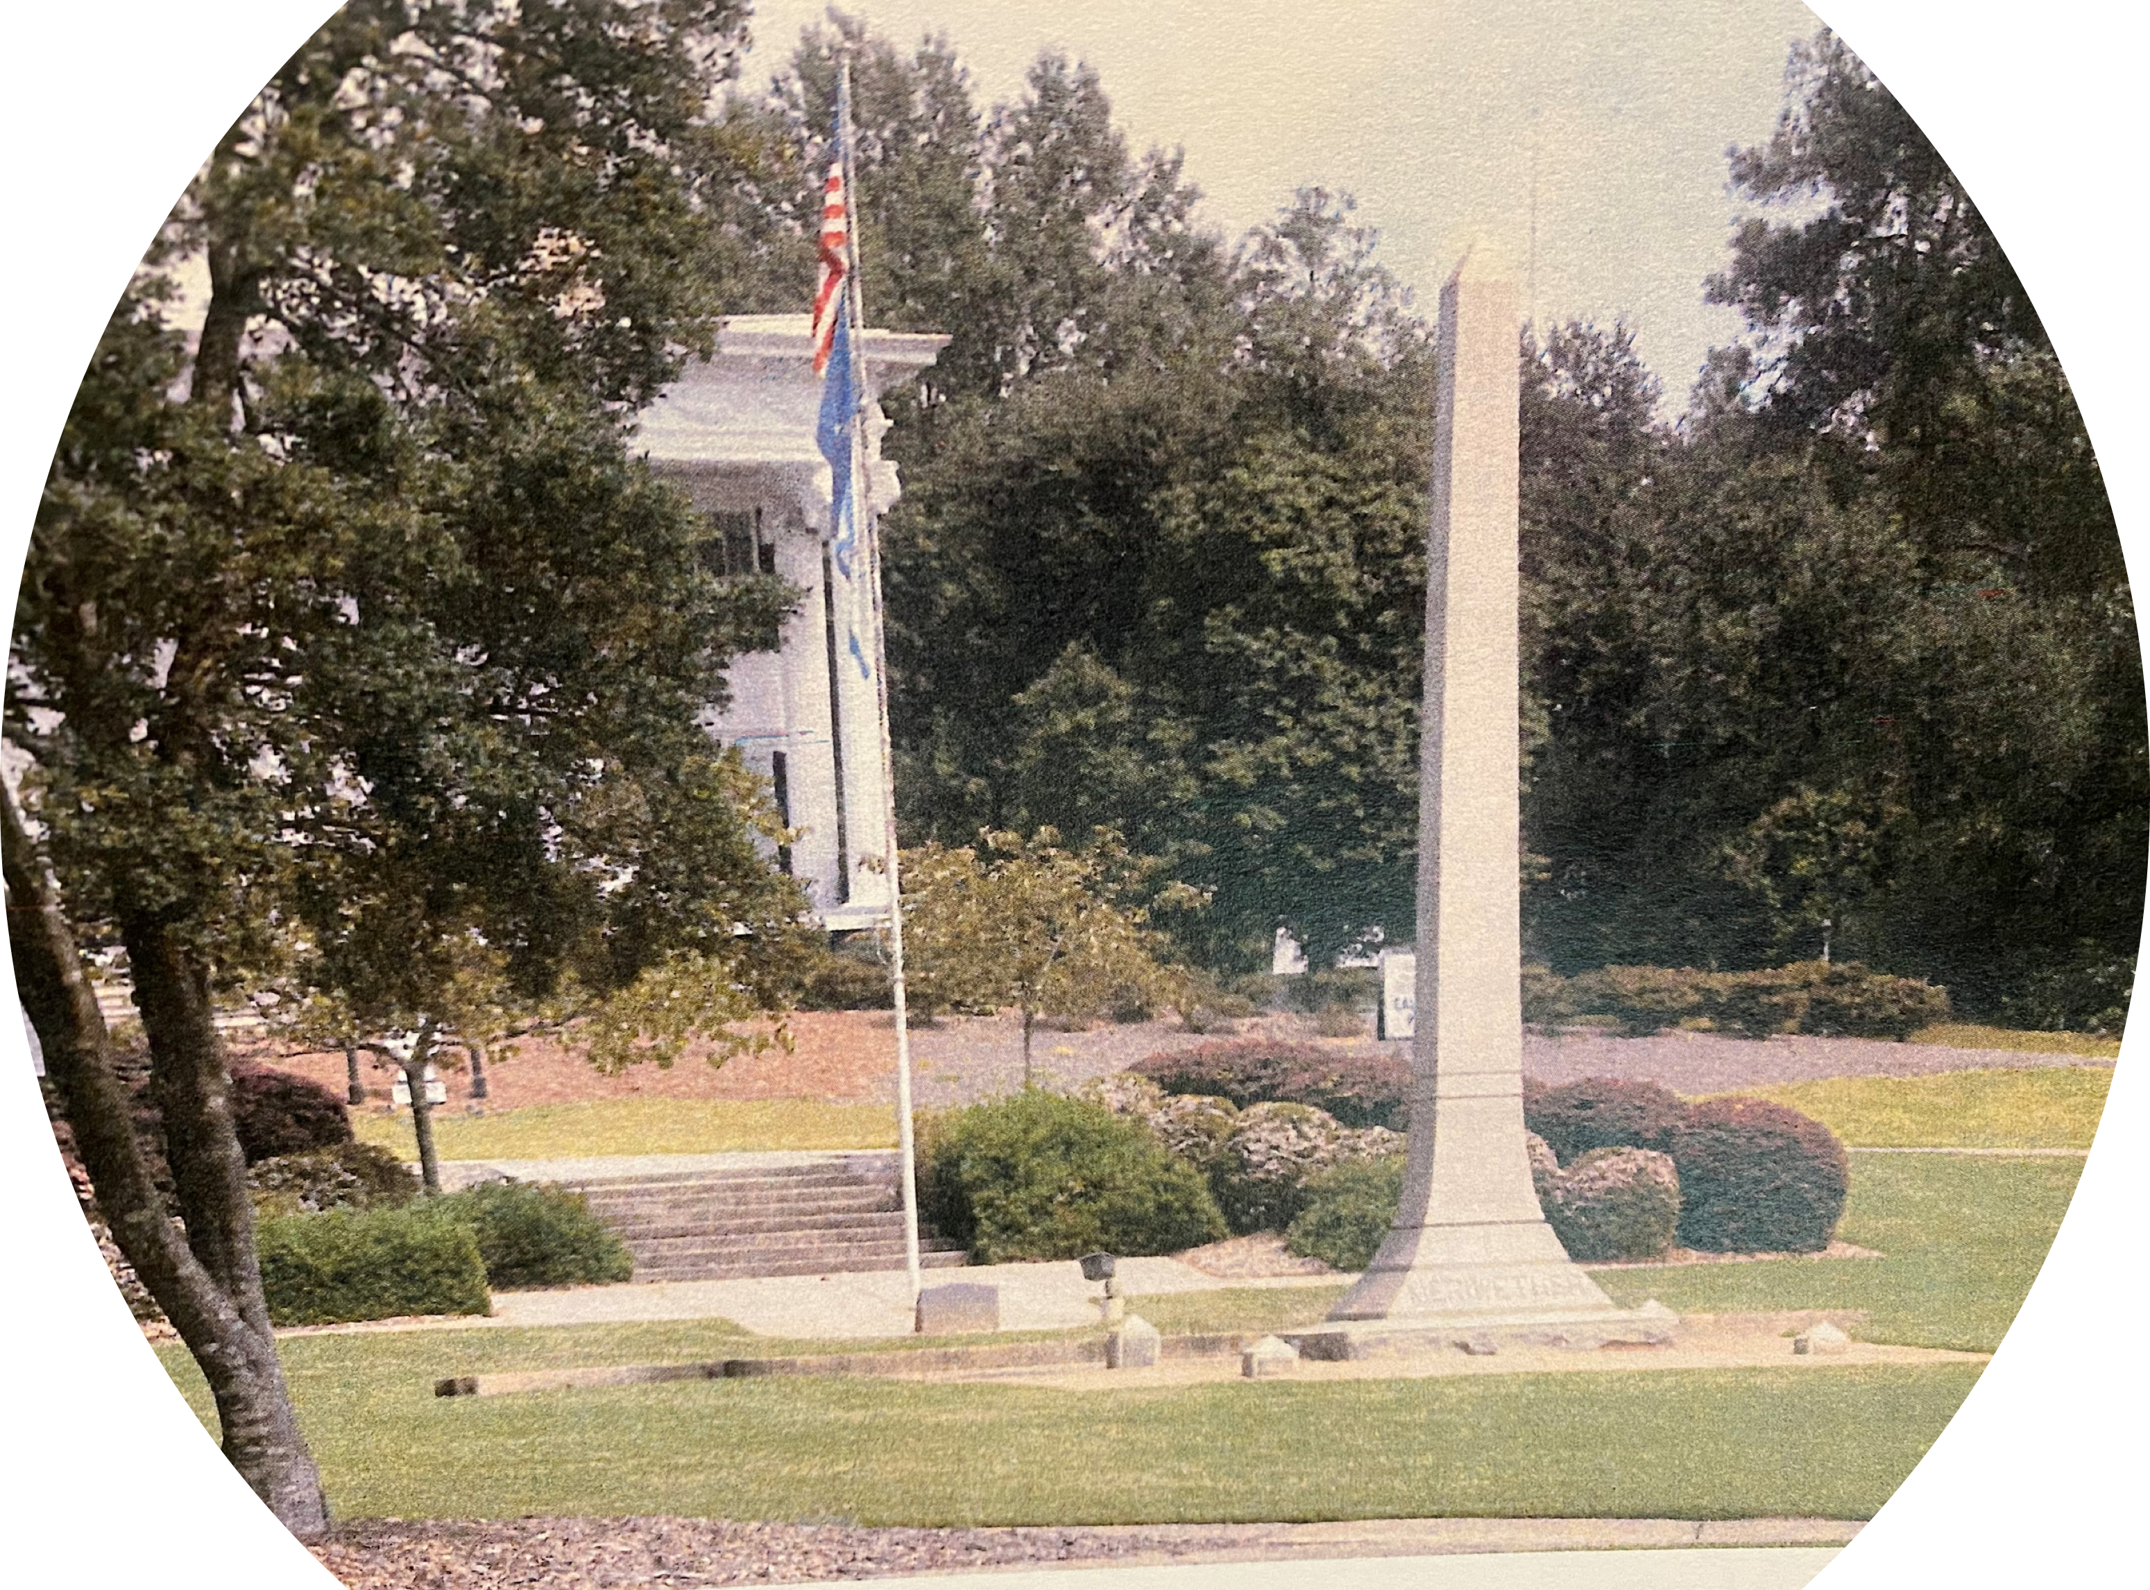
Meriwether Monument

Slide 4
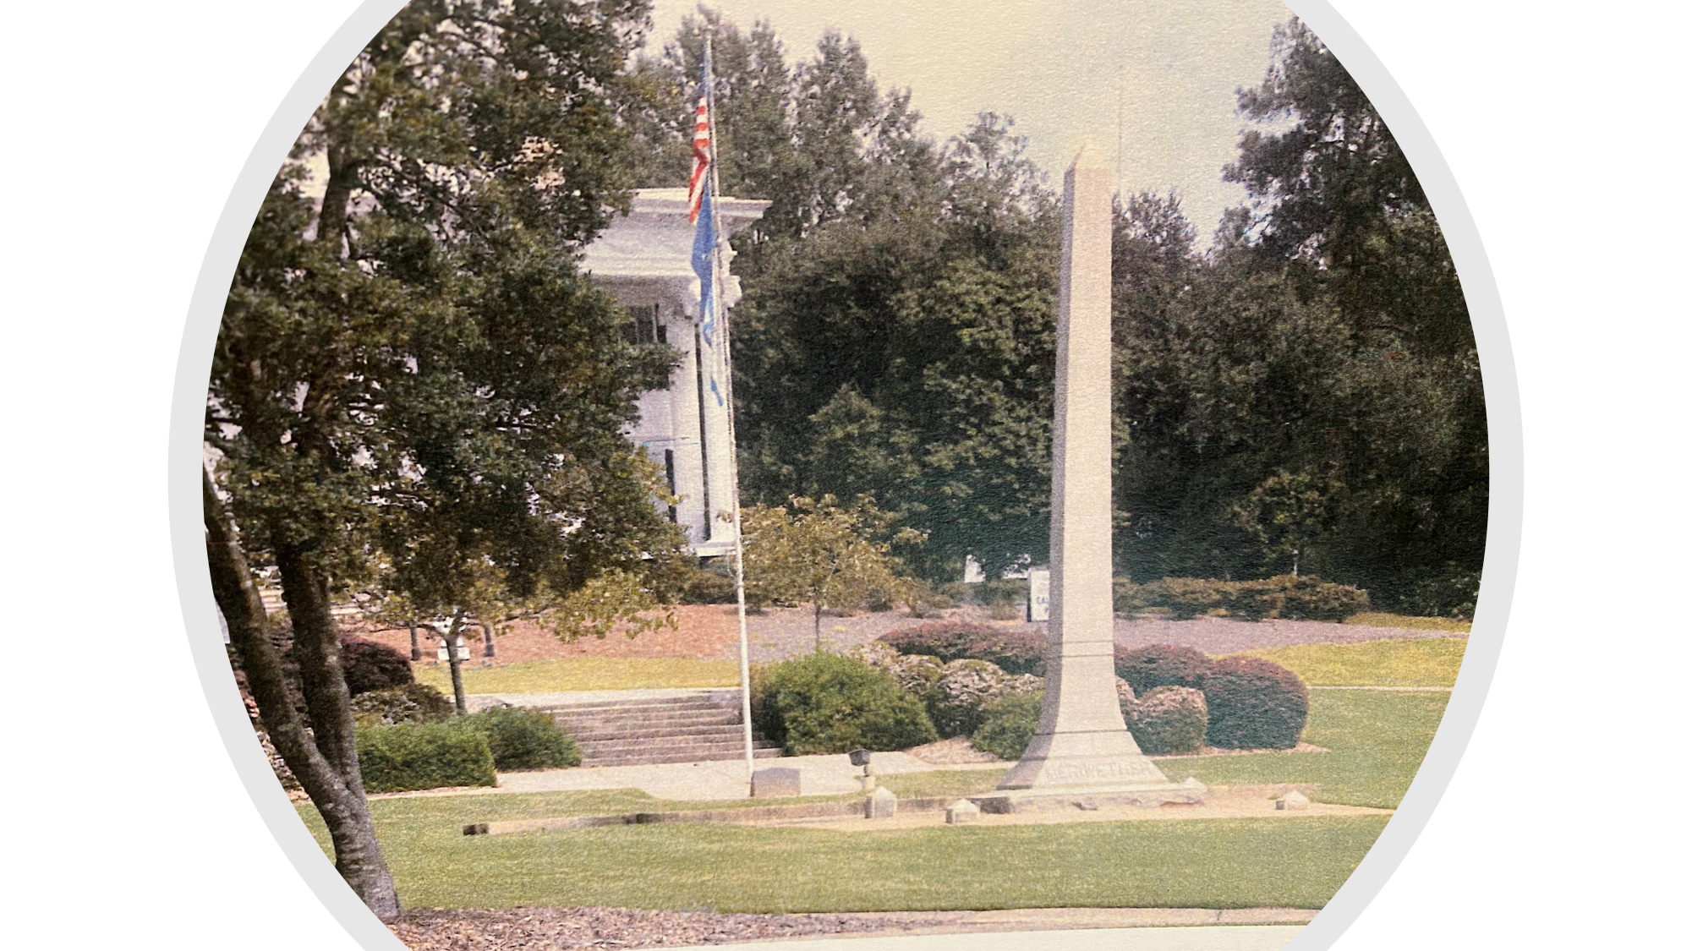
Meriwether Monument
The Meriwether Monument has stood in the center of Calhoun Park since 1916, honoring the one white person who lost his life in the Hamburg Massacre in July 1876.
The words on the monument reflect the attitudes of the citizens of North Augusta at the dedication in 1916, but they clearly do not reflect the opinions and attitudes of North Augusta and its citizens today.

Slide 5
Meriwether Monument
The committee of citizens believes permanent changes to Calhoun Park are necessary to affirm today’s attitudes differ from those expressed on the Meriwether Monument and to explain the events that took place in nearby Hamburg in July 1876.

Slide 6
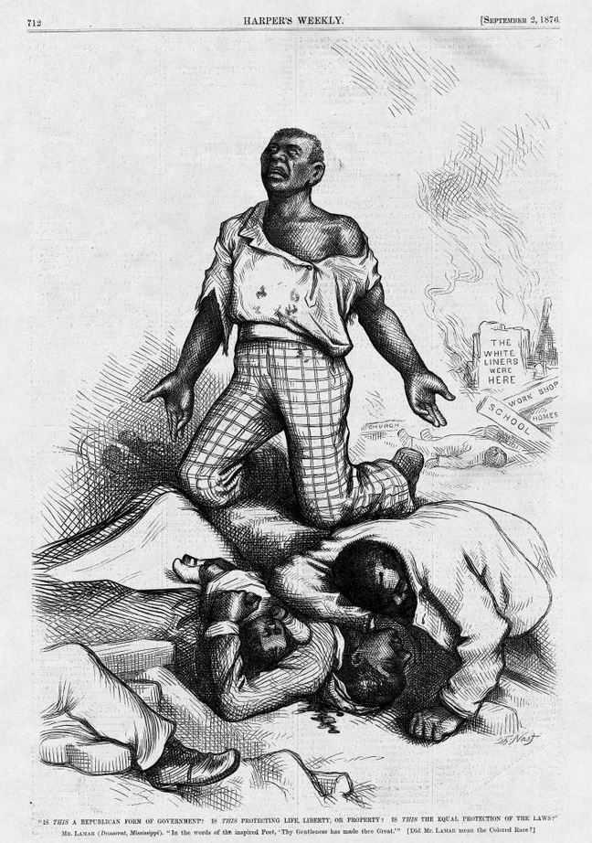
The Hamburg Massacre
The Hamburg Massacre occurred on July 8, 1876.
A gun battle occurred between about 200 men from local rifle clubs and African-Americans serving in Company A, Ninth Regiment of the South Carolina National Guard and others barricaded in a warehouse.

Slide 7
The Hamburg Massacre
Seven African-Americans were killed, four of whom were executed:
First Lieutenant Allen Attaway
Corporal Nelder John Parker
James Cook Albert Myniart David Phillips
Moses Parks Hampton Stephens

Slide 8
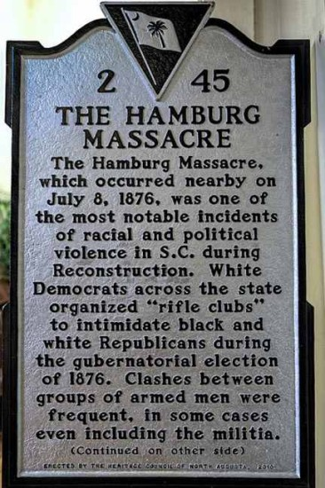
The Hamburg Massacre
The Hamburg Massacre was a historic event in our Nation’s history. It became a key issue in the disputed Presidential election of 1876 between Rutherford B. Hayes and Samuel J. Tilden.
The Electoral College votes from South Carolina, Florida, and Louisiana were contested, and ultimately a special Congressional committee awarded all the contested votes to Hayes, enough to swing the Electoral College to him.

Slide 9
The Hamburg Massacre
Known as the Compromise of 1877, this agreement led to the removal of Northern soldiers from the South, allowing white Southerners to successfully deny African-Americans their rights. This bargain between Southern Democrats and the Republicans brought Reconstruction to an end by ending the Northern occupation of the South.”

Slide 10
The Hamburg Massacre
Historical markers relevant to the City of Hamburg and the events which happened there in July 1876 are positioned at two locations in the city.

Slide 11
The Hamburg Massacre
The Carrsville area is the location of both a roadside marker about the Hamburg Massacre and a Hamburg Granite Memorial to the eight men who died in the Hamburg Incident of 1876. These were dedicated in March 2016.
The cloverleaf at Route 1 and Martintown Road has two Roadside Markers providing information about the City of Hamburg and the Hamburg-Charleston Railroad.

Slide 12
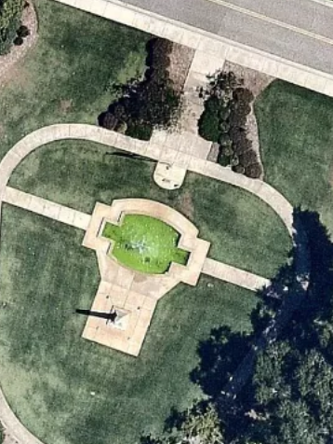
Phase One
Position three Interpretive Panels to provide historical context of the events of July 1876 and the background information about why the Meriwether Monument is located in Calhoun Park.
This initial phase, to purchase and erect interpretive panels, estimated to cost $8,000 to $10,000.
Interpretive Panels with Text

Slide 13
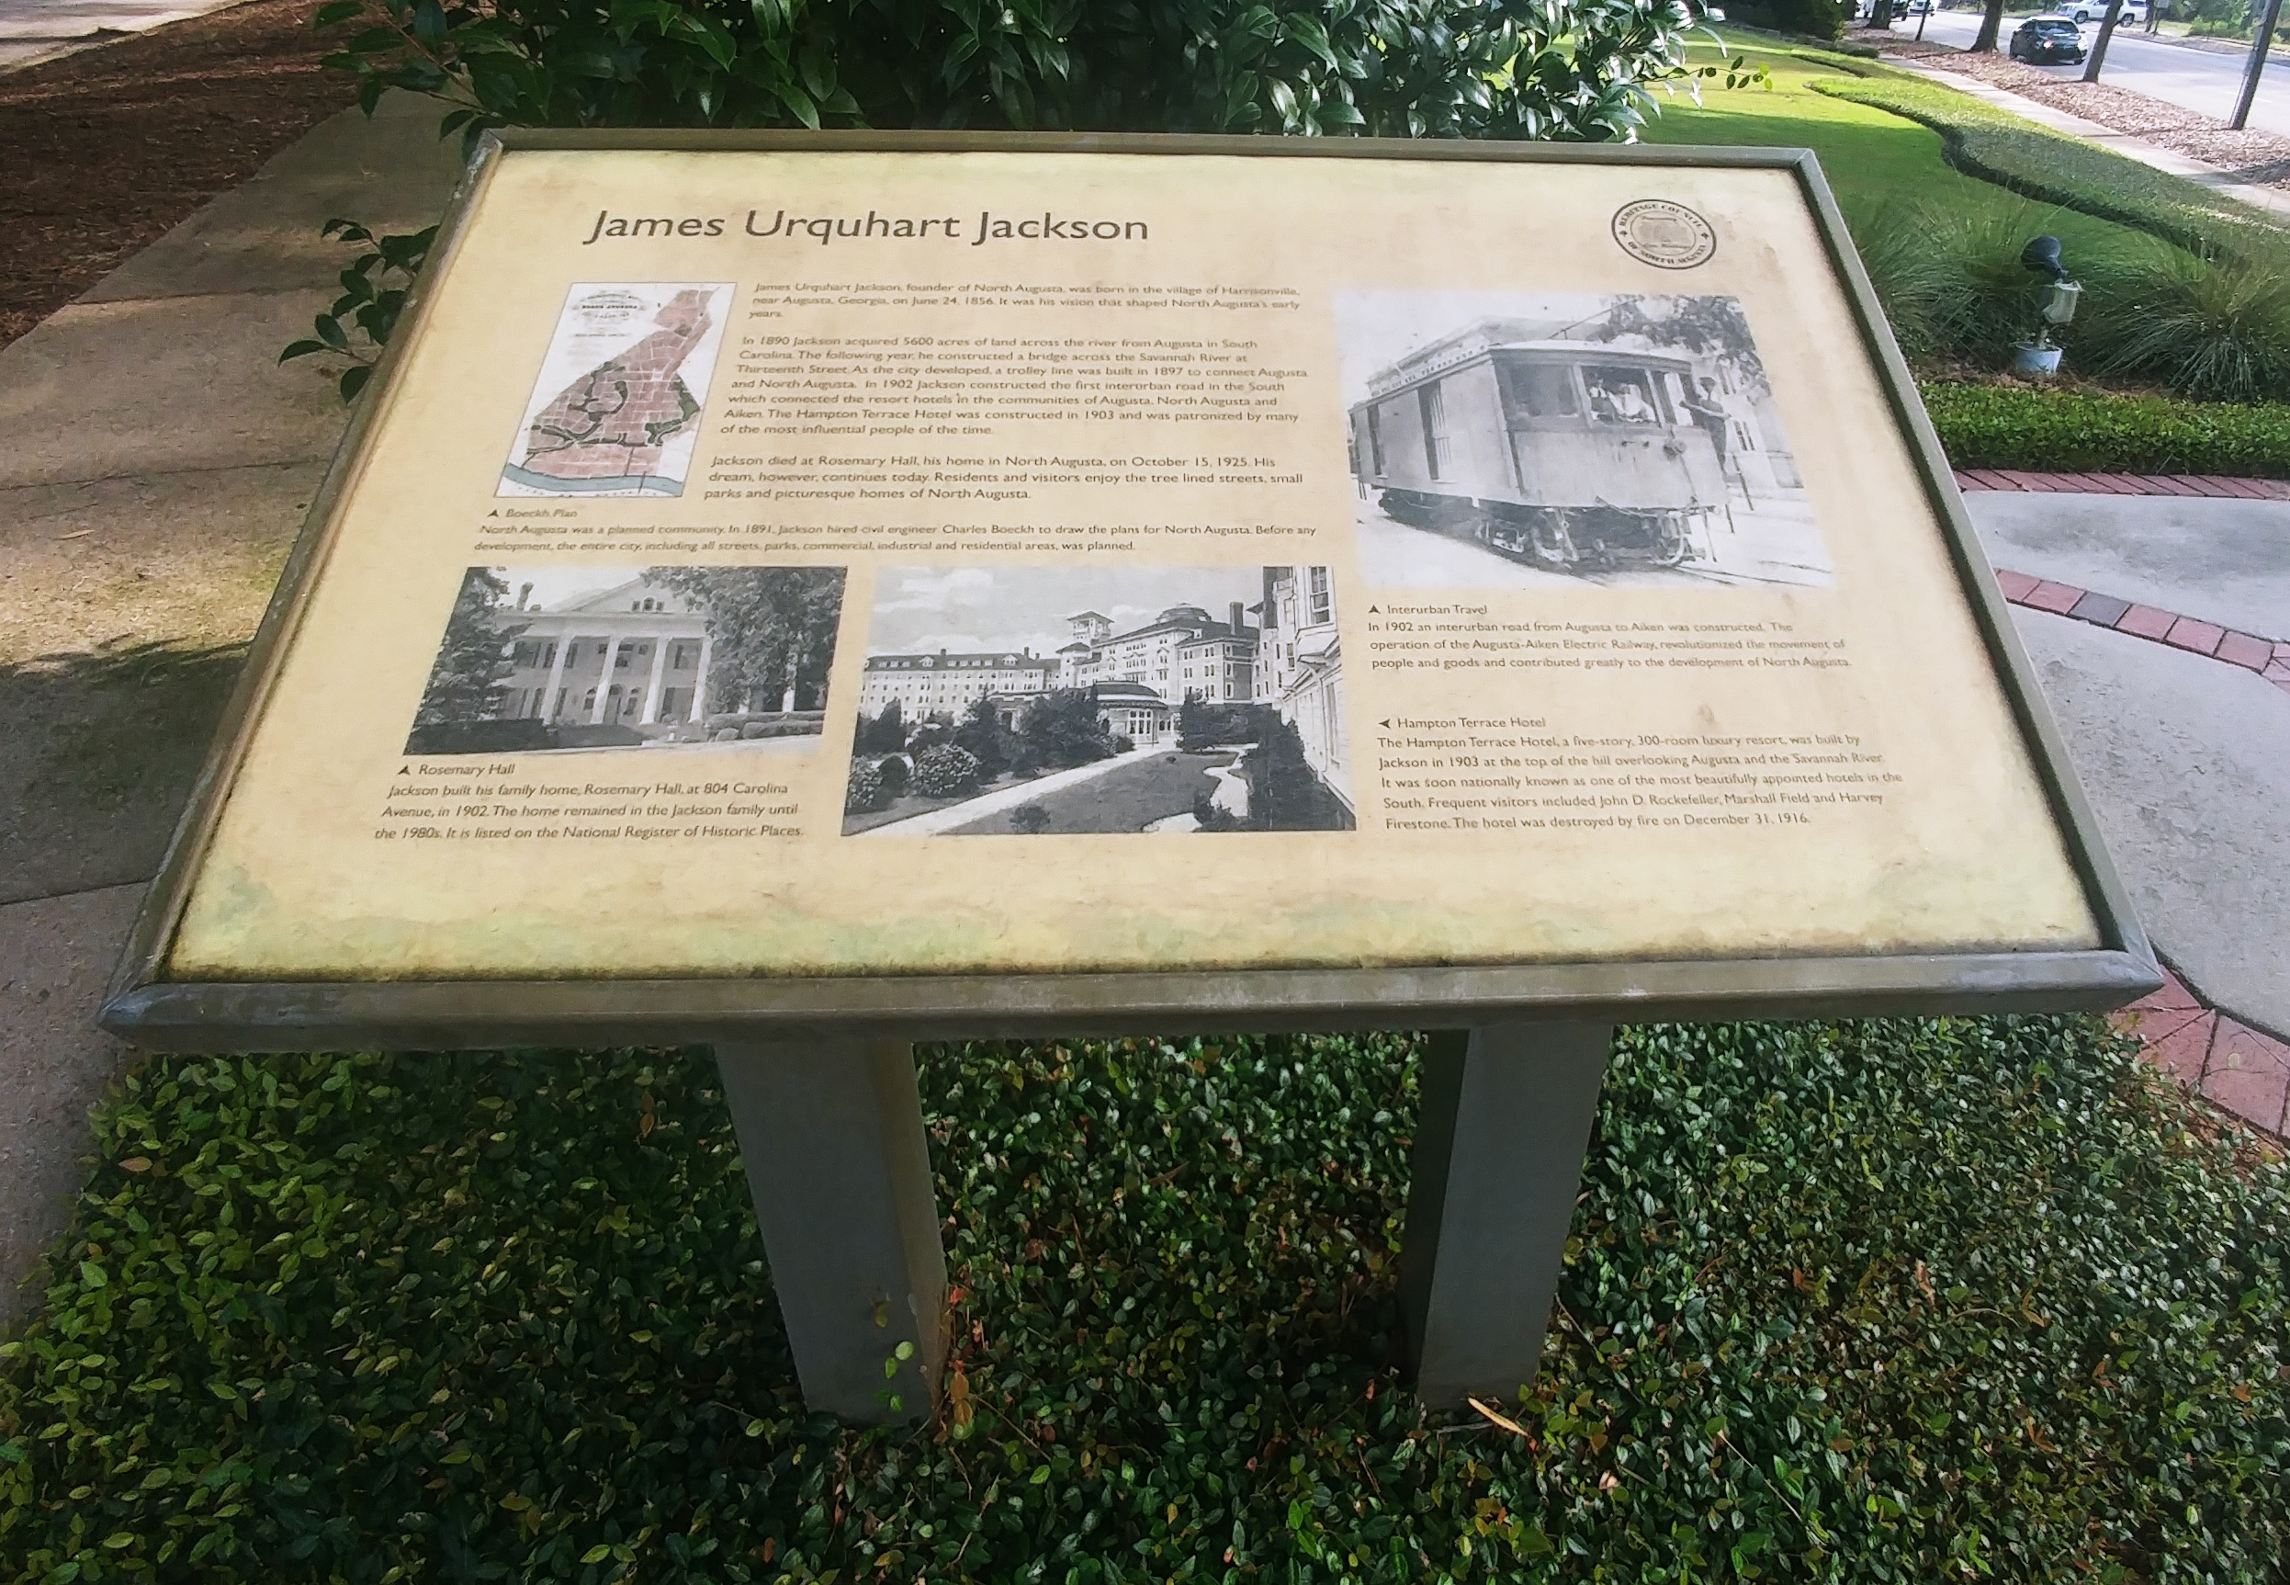
Interpretive Panel

Slide 14
First Interpretive Panel
“After the Civil War, the nearby Town of Hamburg, SC became a town where free blacks and freed slaves settled. Important local government positions were held by African-American leaders from the Town of Hamburg. The most notable were Prince Rivers, Samuel Lee, and John Gardner.
The 1868 South Carolina elections produced the first majority black state legislature in U.S. history. A new South Carolina constitution was drafted. Aiken County was formed from parts of Edgefield, Lexington, Barnwell, and Orangeburg counties. It was the only county formed in South Carolina during the Reconstruction Era (1865-1877). March 10, 1871 is celebrated as Founders Day in Aiken County.”

Slide 15
Middle Interpretive Panel
“The Hamburg Massacre occurred nearby on July 8, 1876. A gun battle occurred between about 200 men from local rifle clubs and African-Americans serving in Company A, Ninth Regiment of the South Carolina National Guard and others barricaded in a warehouse. Seven African-Americans were killed, four of whom were executed. The Black casualties were First Lieutenant Allen Attaway, Corporal Nelder John Parker, James Cook, David Phillips, Albert Myniart, Moses Parks, and Hampton Stephens. The sole white casualty was Thomas McKie Meriwether.
(Continued)

Slide 16
Middle Interpretive Panel, cont.
The Hamburg Massacre was a historic event in our Nation’s history. It became a key issue in the disputed presidential election of 1876 between Rutherford B. Hayes and Samuel J. Tilden. The Electoral College votes from South Carolina, Florida, and Louisiana were contested, and ultimately a special Congressional committee awarded all the contested votes to Hayes, enough to swing the Electoral College to him.
Known as the Compromise of 1877, this agreement led to the removal of Northern soldiers from the South, allowing white Southerners to successfully deny African-Americans their rights. This bargain between Southern Democrats and the Republicans brought Reconstruction to an end by ending the Northern occupation of the South.”

Slide 17
Last Interpretive Panel
“In 1914, the S. C. Legislature passed a bill authorizing $400 for a headstone on the grave of Thomas McKie Meriwether, the one white person killed in the Hamburg Massacre. A 1915 amendment authorized placing the monument within the town of North Augusta. Local leaders chose this prominent location as the site for the monument. Private funds supplemented the funds authorized by the S.C. Legislature. The monument was dedicated February 16, 1916.
(Continued)

Slide 18
Last Interpretive Panel, cont.
“Inscriptions on the monument reflect attitudes of people during that period. Those words do not represent the attitudes of the people of North Augusta today. We are a community of people of different races and ethnic backgrounds, bonded together by unity and common rights of citizenship. We choose to learn from our past and ensure that North Augusta’s future reflects a high standard for all of its citizens. The events and legacy of Hamburg do not define us.”

Slide 19
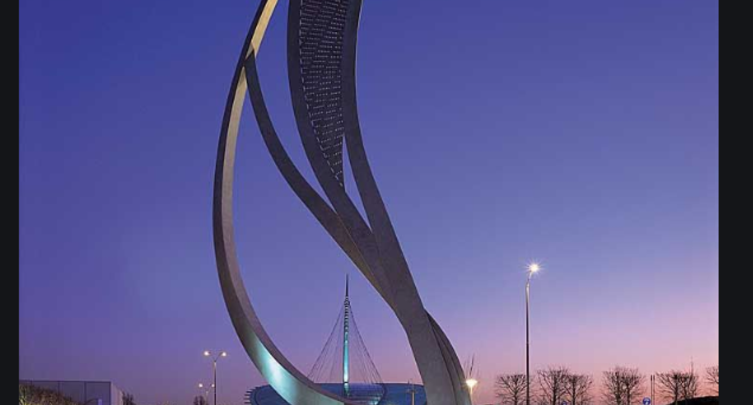
Phase Two

Slide 20
Phase Two
A sculpture in Calhoun Park with the theme:
“Unity to embody the conviction that our community consists of many races and cultures enjoying full rights of citizenship.”
It is important that the African-American victims of the Hamburg Massacre are honored in Calhoun Park in addition to the Interpretive Panels.
An Open Design Competition
The cost for a suitable sculpture will be in the range of $200,000.
Shared public and private funding campaign.

Slide 21
Finally,
We strongly recommend active support, including a financial commitment, toward development of an African-American historical district in Carrsville.
This does not necessarily mean formally establishment of such a district, but that possibility should be considered.
An initial step would be relocating the roadside markers providing information about the City of Hamburg and the Hamburg-Charleston Railroad to Carrsville.

Slide 22
Finally,
Council’s decision to leave the Meriwether Monument unaltered shapes the conclusion that Calhoun Park should be the single location within the City focused on the Historical Hamburg Massacre
The wishes of the African-American community to have the marker and the memorial remain in Carrsville dictate that two separate areas will have descriptive information about the Hamburg Incident. While this may not be the ideal situation, having the marker and memorial in Carrsville will provide an additional incentive for visits to Carrsville.

Slide 23
Thank You

